Slide 1
Introduction
Introduction to course
Binary numbers
bits and bytes
MSB and LSB
Data representation
Binary numbers,
Hexadecimal
Base conversions,
addition, subtraction
2’s compliment
signed integer notation
flags

Slide 2
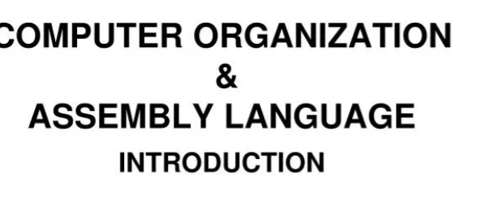

Slide 3
Computer Organization and Architecture
It is used to design computer systems.
Computer Architecture is considered to be those attributes of a system that are visible to the user like addressing techniques, instruction sets, and bits used for data, and have a direct impact on the logic execution of a program
Computer Organization is the way in which a system has to structure and It is operational units and the interconnections between them that achieve the architectural specifications, It is the realization of the abstract model, and It deals with How to implement the system.

Slide 4
Computer Architecture and Organization
Architecture describe What computer does
Organization describes how it does
Architecture indicates its hardware
Organization indicates its behaviour
For designing a computer, its architecture is fixed first.
For designing a computer, an organization is decided after its architecture.

Slide 5
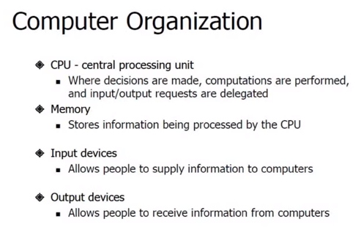

Slide 6
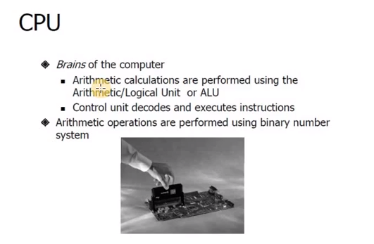

Slide 7
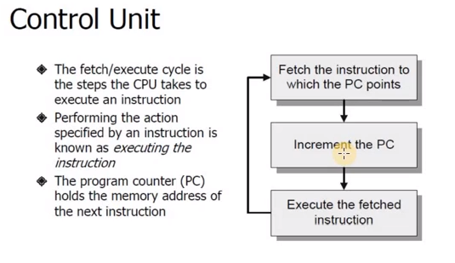

Slide 8
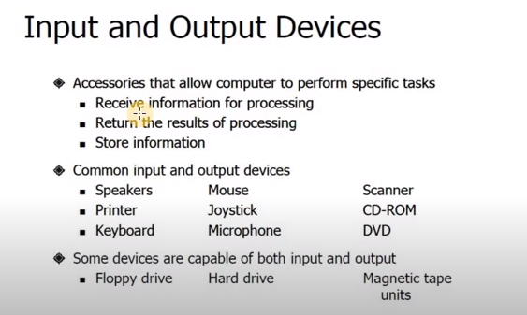

Slide 9
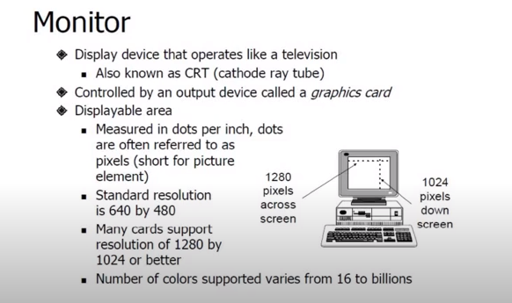

Slide 10
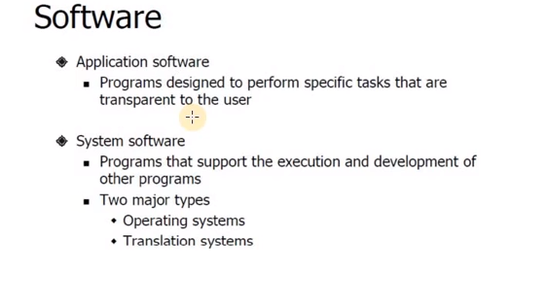

Slide 11
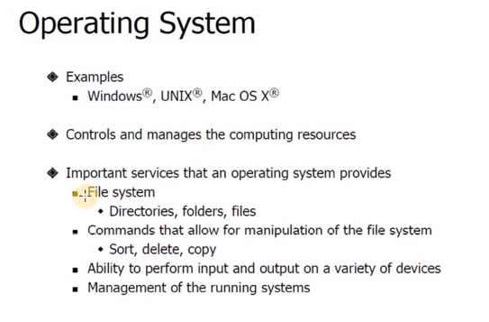

Slide 12
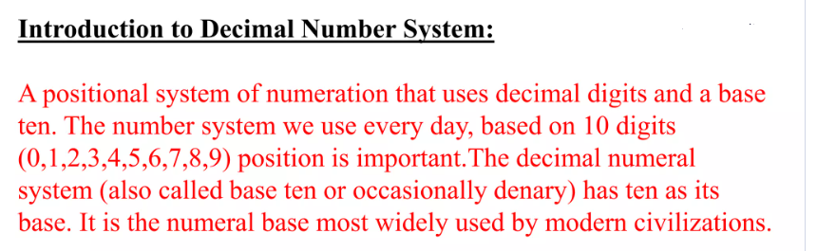

Slide 13

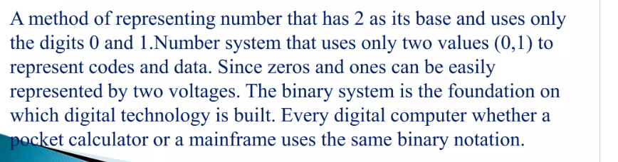

Slide 14
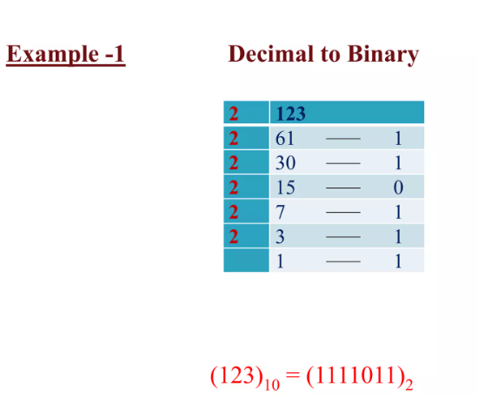

Slide 15
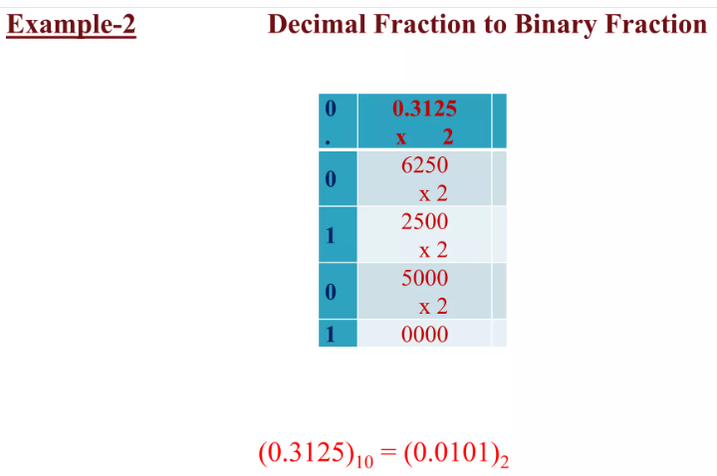

Slide 16
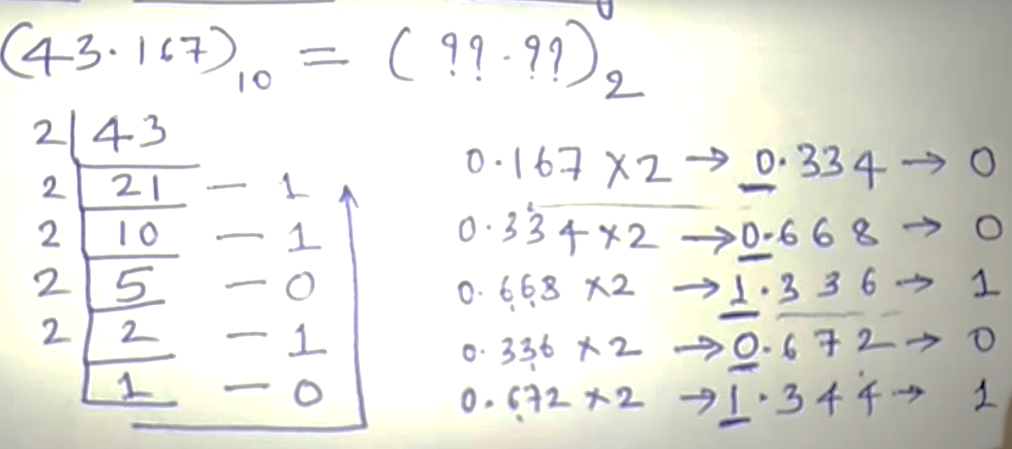

Slide 17
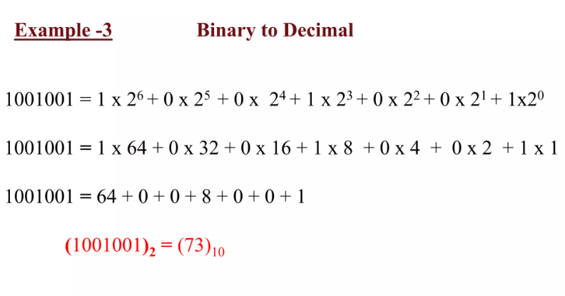

Slide 18
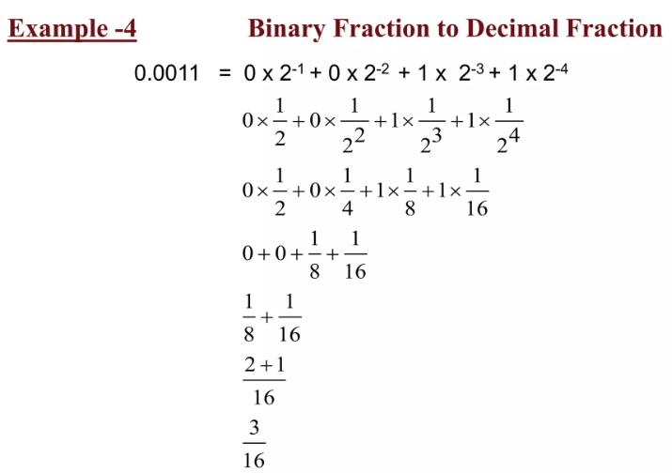

Slide 19
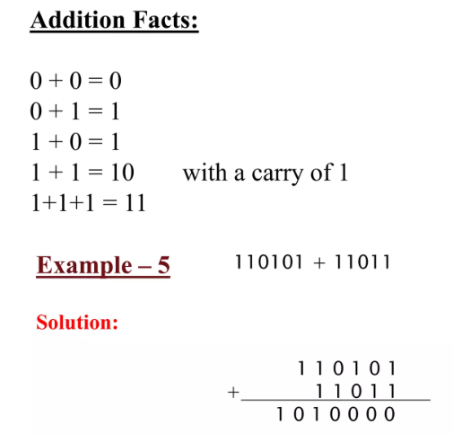

Slide 20
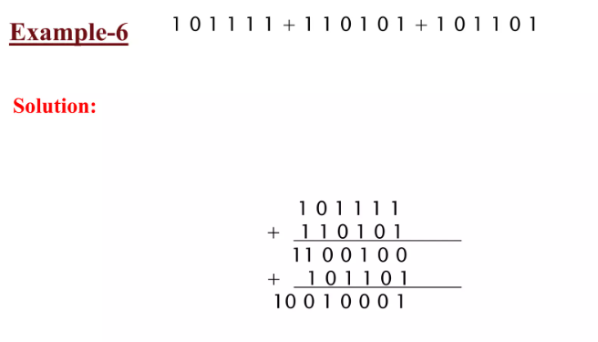

Slide 21
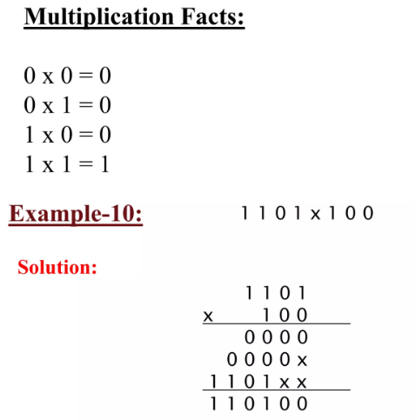
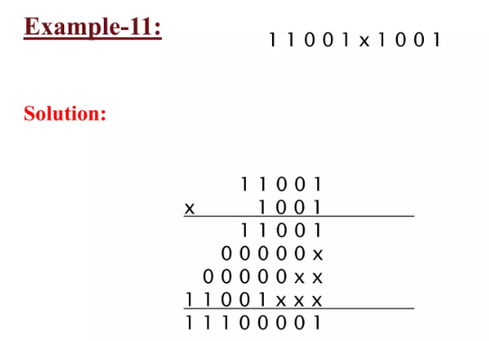

Slide 22
Subtraction Facts:
0-0 =0
1-0=1
1-1=0
0-1= 1 (but 0 have to borrow 1 from left side)
1110 1100 11000 11000
0101 0101 00001 01111
1001 0111 10111 01001

Slide 23
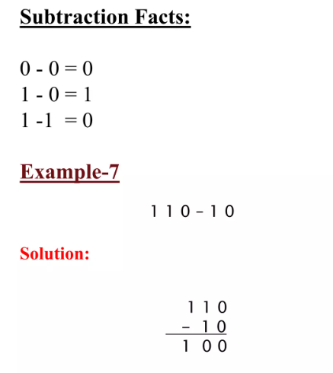
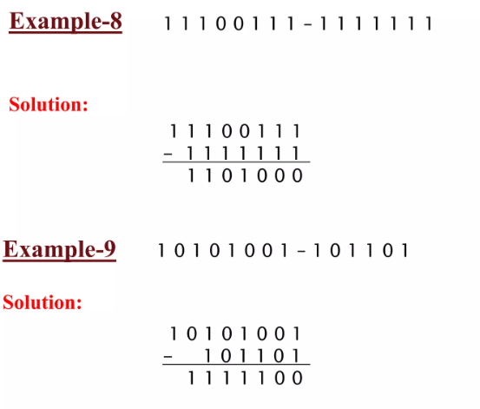

Slide 24
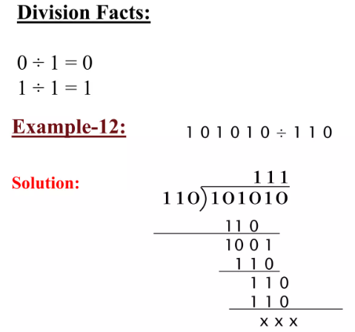

Slide 25
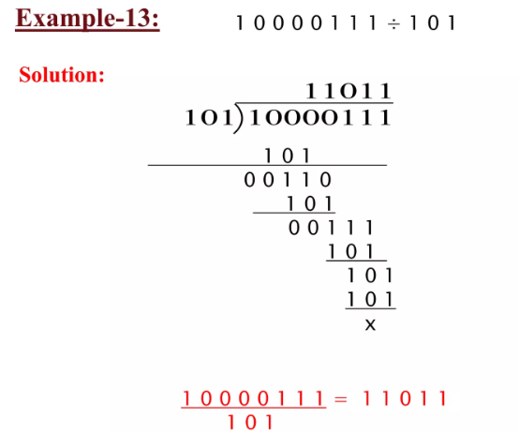

Slide 26
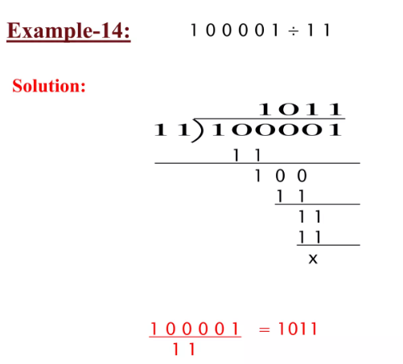

Slide 27
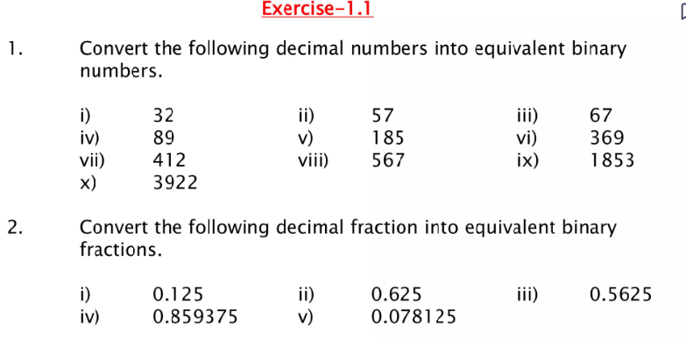
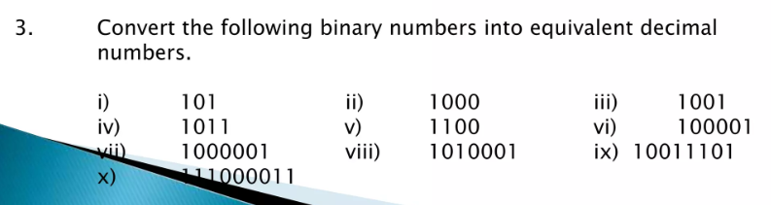
Assignment No: 1
Note: Assignment must be handwritten and only use A4 size pages.
Submission Date: Next working class. Handover to your CR.

Slide 28
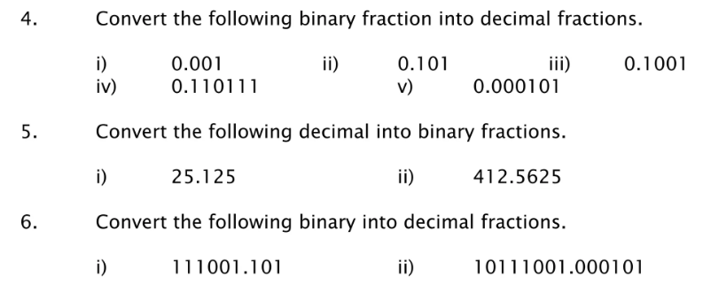
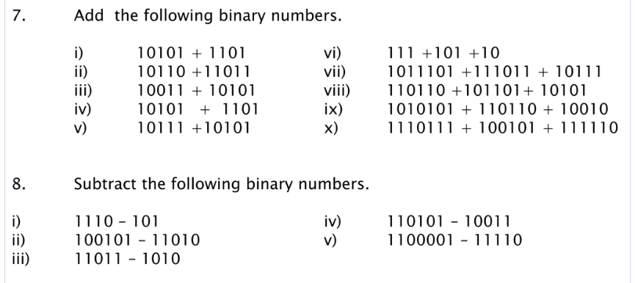

Slide 29
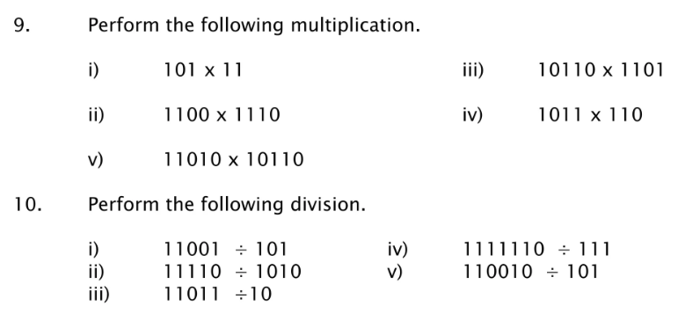

Slide 30
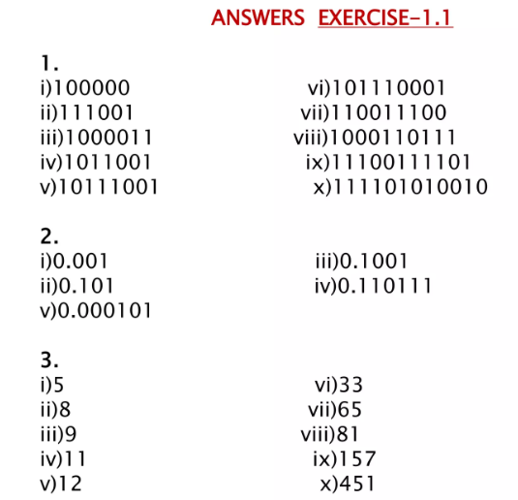

Slide 31
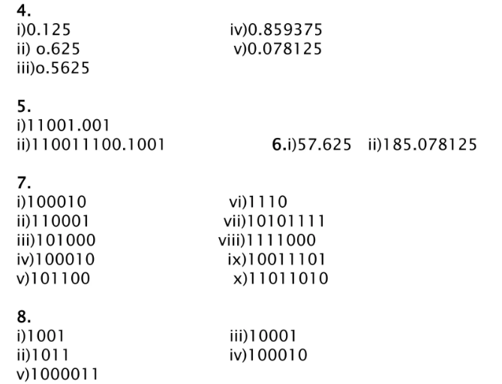

Slide 32
